Slide 1
Wikidata.lib

Slide 2
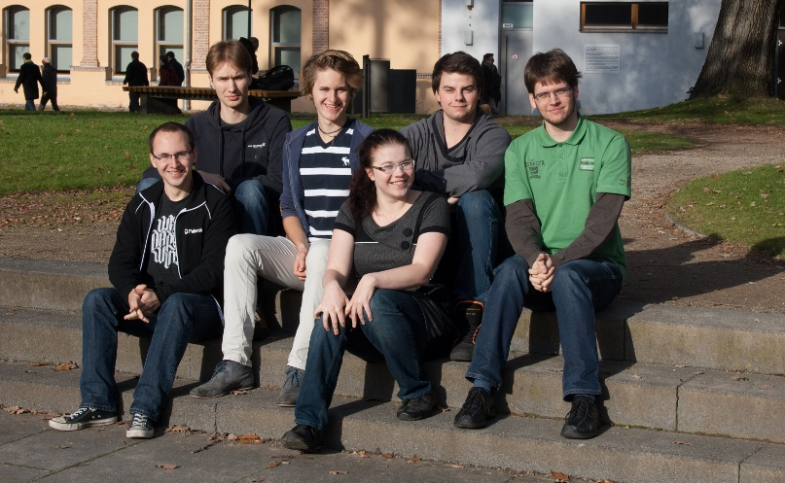
Who are we?
Sebastian Brückner
Christian Dullweber
Felix Niemeyer
Virginia Weidhaas
Moritz Finke
Alexander Lehmann

Slide 3
Agenda
Introduction to Wikidata
Wikidata Prozess
Generelle Aufgabe: Was ist Wikidata? Wikidata verbessern(Aufgaben)
Demo - vorher/nachher
Verfahren
- leere Objekte, volle Objekte, klassifizierer
Datenerfassung, vorberechnung
Suggestion berechnung mit mysql
Rapidprototyping/Entwicklungsprozess

Slide 4

Wikidata
Structured database providing a common source of certain data types (e.g. names, birth dates, …)
Wikipedia (and other projects) can use the data to avoid duplication and
Development split into three phases:
Centralizing interlanguage links – links between Wikipedia articles about the same topic in different languages
Providing a central place for infobox data for all Wikipedias
Creating and updating list articles based on data in Wikidata
Notes:
Phase 1 begann: 30. Oktober 2012
Inter-language links in allen Wikipedias aktiviert: 06. März 2013
Phase 2 begann: 04. Februar 2013

Slide 5
Project Organization
Our partner: Wikimedia Germany, responsible for the development of Wikidata
Our task: improve access to Wikidata
Hangout meeting once a week
Work from the WMDE office in Berlin (tomorrow)
Communication via mailing lists and IRC

Slide 6
PubSubHubbub
PubSubHubbub (PuSH) is a protocol that enables resources to push changes to subscribers.

Slide 7
MediaWiki Extension
Uses MediaWiki hooks to intercept saving articles
Currently, we fully support MediaWiki articles
In the future, we will also support:
Changes to WikiData objects
Creation of new articles / WikiData objects
Deletion of articles / WikiData objects
Content pushed to subscribers is either WikiMarkup (for articles) or JSON (for WikiData objects)

Slide 8
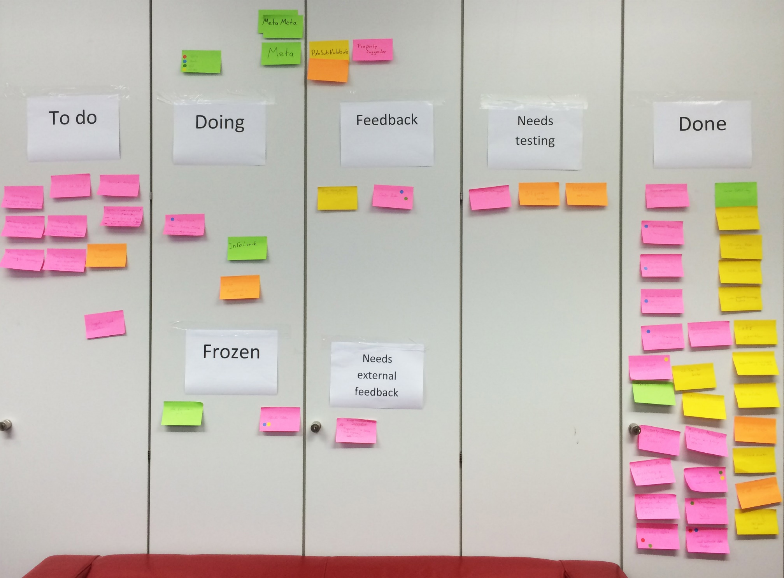
Wikimedia services
GitHub
Git
MediaWiki.org
Gerrit
Jenkins
BugZilla
Notes:
GitHub:
Startpunkt, da wir nicht direkt auf Wikimedia-Servern arbeiten konnten (Projekt beantragen…)
Bachelorprojekt-Wiki befindet sich immernoch dort
MediaWiki:
Beschreibung unserer Extension: Infos, Installationsanleitung, Konfiguration…
Verweis auf Repository / Gerrit / BugZilla
BugZilla:
Ticketverwaltung, verwenden wir derzeit nicht
Stattdessen Scrum-Board am Schrank (CLICK)
Git:
Muss beantragt werden / dauert 2-3 Wochen
Interaktion nur über Gerrit

Slide 9
commit
Existing Code
Writing patch
Patch ready
Create branch
Squash changes
into 1 commit
Publish to Gerrit
Jenkins
Unit tests
Linting
Awaiting linting
Automatic check
and verify
success
fail
Amend commit
Patch merged
Awaiting Reviews
Change required
+2
-1

Slide 10
Wikitech / Wikimedia Labs
Wikimedia Labs is an OpenStack infrastructure
To create own VMs, we had to apply for a Labs project
Public IPv4 address (MediaWiki needs to be reachable for the hub)
Plain VMs, no software / database preinstalled
Notes:
Projekt-Antrag braucht ca. 2-3 Wochen

Slide 11

Intelligent Forms
Notes:
Auf UI hinweisen, im Vergleich zum alten

Slide 12
Development Process
Wikidata contacts
Lydia (Product Manager)
Daniel (Developer)
Abraham (Project Manager)
Rapid prototyping
Weekly hangouts
Instant review
Incremental improvement

Slide 13
Workflow
XML/JSON Dump
Feature CSV
PHP Suggester
Suggestions
Dump parser
MySQL Table
Calculate Correlations

Slide 14
Workflow
XML/JSON Dump
Feature CSV
PHP Suggester
Suggestions
Dump parser
MySQL Table
Calculate Correlations
XML Dump (25GB)
Contains all Wikidata pages and JSON data in the <text> tag
Convert to CSV
Python
XML Stream Parser (xml.etree.cElementTree)
JSON Parser (ujson)
30minutes
CSV (1.7GB)
Q1,31,wikibase-entityid,Q223557
Entity: Q1 (Universe)
Property: 31 (instance of)
Property Type: wikibase-entityid
Value: Q223557 (Physical Object)

Slide 15

Workflow
XML/JSON Dump
Feature CSV
PHP Suggester
Suggestions
Dump parser
MySQL Table
Calculate Correlations
Analyse CSV (1.7GB)
Create table for all combinations of properties
Count occurances of these combinations
$correlation\left(p_{1},p_{2}\right)=count\left(p_{1},p_{2}\right)/count\left(p_{1}\right)$
30 seconds
Write table to MySQL DB
propertyPairs(pid1 INT, pid2 INT, correlation FLOAT)
700*700 = 490,000 potential combinations
Only pairs with correlation > 0
Reduced to 43,000 tuples

Slide 16
Workflow
XML/JSON Dump
Feature CSV
PHP Suggester
Suggestions
Dump parser
MySQL Table
Calculate Correlations
MySQL Table
wbs_propertyPairs(pid1 INT, pid2 INT, correlation FLOAT)
Provide Suggestions
Input: an Entity E
$L = properties of E
$threshold = minimum correlation
$size = count($L)
SELECT pid2, sum(correlation)/$size AS cor FROM propertyPairs WHERE pid1 IN $L AND pid2 NOT IN $L GROUP BY pid2 HAVING sum(correlation)/$size > $threshold ORDER BY cor DESC LIMIT $limit

Slide 17

Work in Progress / Future Plans

Slide 18
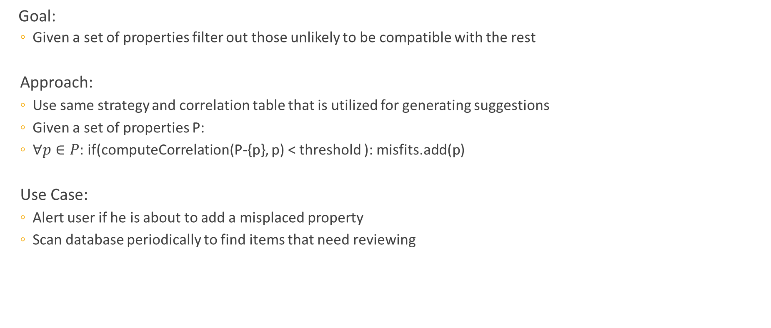
Finding “Misfits“
Goal:
Given a set of properties filter out those unlikely to be compatible with the rest
Approach:
Use same strategy and correlation table that is utilized for generating suggestions
Given a set of properties P:
$∀p∈P:$ if(computeCorrelation(P-{p}, p) < threshold ): misfits.add(p)
Use Case:
Alert user if he is about to add a misplaced property
Scan database periodically to find items that need reviewing
Notes:
Beispiel: Mensch hat idR keinen Staat sondern eine Staatsbürgerschaft etc…
Scan part of database
Offenheit von wikidata erklären, user darf nichts verboten bekommen!

Slide 19
Adjust Property Ranking
Motivated by possible use cases:
Downgrade rank of identifiers (mostly filled in by bots)
Take user feedback into consideration
Strategy
Maintain extra column “adjustment value“ in table properties
Update by analysing wikidata dumps, user feedback etc.
Join “propertyValuePairs“ with “properties“ during ranking process

Slide 20
Classifiers
Why classifiers?
Items in the same class often have similiar sets of properties
Classifier-Value-Pairs useful for finding appropriate suggestions
Great suggestions for items without existing properties
Generating suggestions based on classifiers is analog to what is done now
Ideas on identifying useful/good classifiers:
They should be used frequently -> good guess if no other information is available
Their values are items (classes represented by an item in wikidata)
Items in the same class should have more in common than others
Notes:
Classifiers = attribut that connect an item to a class
Great suggestions for items without preexisting properties –why!!
Only care about frequently used -> good guess if no other information is available

Slide 21
Algorithm for finding Classifiers
Only consider properties with datatype item
Find the 10 most frequently used properties
Rate every property p as follows:
Suggestions = []
Find the 10 most frequent values for p (most common classes)
For every class do:
If a property appears in > 50% of the class members: Suggestions.add(property)
If a suggestion is found for > 30% of all items described by p: Suggestions.remove(property)
Rating(p) = len(Suggestions)
Satisfying results when used on the current dump -> Top rated classifiers: instanceOf & occupation
Notes:
Algorithm for generating suggestions based on classifiers IS very similiar to our general approach:
->Now one extra table for each classifier with one row for each classifier-value-combination
Percentage thresholds and number of properties/classes can/could be adjusted
Examples during explanation: sex vs instanceOf

Slide 22
Finding Examples / Representatives
Finding good representatives for classes:
Items with most properties
Items most edits (and other meta information)
When an item is being edited:
Use classifier information or other metric to find similiar items (items in the same class)
Identify good representatives for the current item‘s class
Support edit process by providing user with examples from these items

Slide 23


